Slide 1
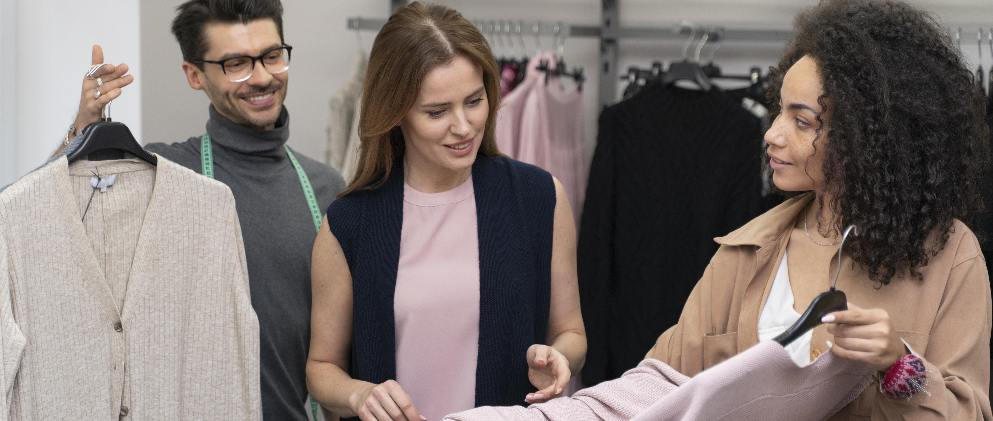

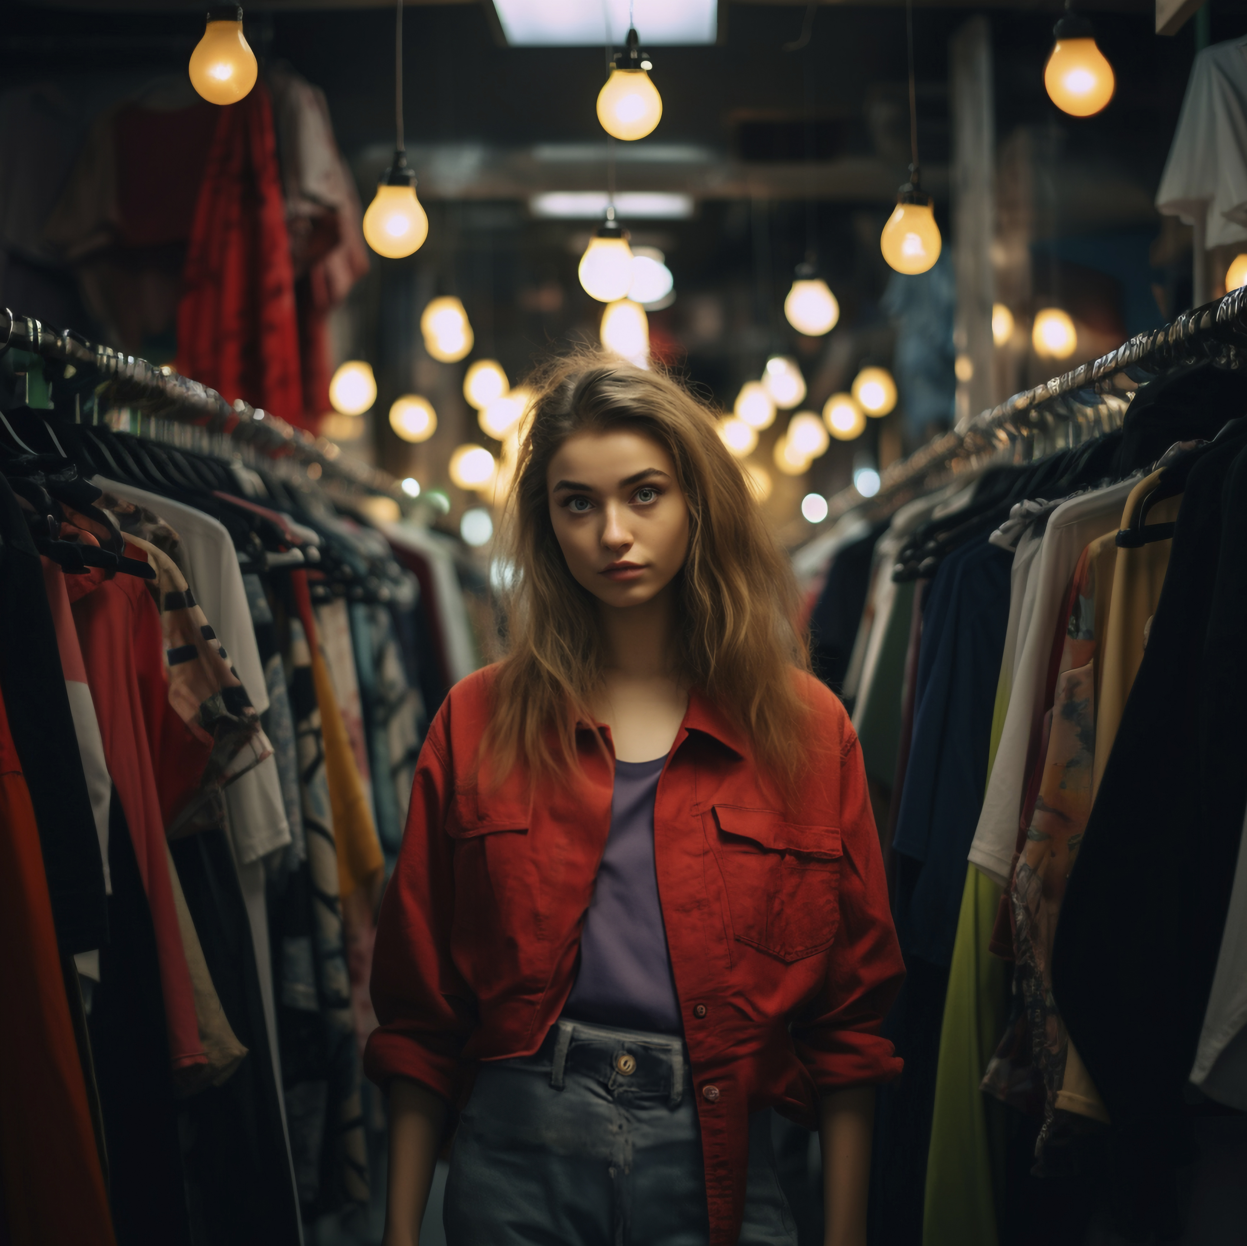

A Smarter Model
FASHION THAT SUSTAINS
How Off-Price Fashion Drives Circularity, Inclusive Growth and Sustainable Industry.

Slide 2





Rethinking Fashion Waste
Where Does Fashion Waste Go?”
The fashion industry is drowning in excess—and it’s costing us the planet.
1%
14%
92 million tons of textile waste are generated every year.
12%
Unsold inventory is often incinerated or sent to landfills.
73%
Fast fashion worsens this with short cycles and mass production.
Off-price fashion gives these products a second life—extending their life cycle while reducing waste.
Instead of letting clothes die in silence, off-price fashion gives them a voice again.
Ellen MacArthur Foundation, 2021

Slide 3




What Is Off-Price Fashion?
Off-price is not about low value—it's about smart reallocation.
Overproduction.
Involves selling excess, canceled, or unsold inventory at discounted prices.
Canceled orders.
Not the same as thrift or secondhand—these are new garments from top brands.
Supply Sources for Off-Price Fashion
Common sources of excess.
Excess inventory.
Overproduction.
Retailer cancellations.
Shipment delays.
Mismatched colors or sizes.
End-of-season stock
It’s fashion’s version of resource recovery.

Slide 4





Circularity In Action
Production
Off-price Fashion is a critical node in the circular economy.
Prevents waste by redistributing goods already manufactured.
Retail
Extends product life without requiring new raw materials.
Overstock
Off-Price in the Circular Fashion Loop
Off-price sale
Complements other circular practices like.
Repair & resale (Patagonia Worn Wear).
Rental models (Rent the Runway).
Recycling (Nike Grind).
Use
Off-Price is scalable—operates across thousands of clothing brands and styles.
Recycle or Resell
Raw materials
Circularity isn’t just reuse—it’s reinvention.

Slide 5




Economic Impact
Jobs Creation & Sustainable Business Models (SDG 8 )
Off-Price Fashion = Economic Engine
Circularity isn’t just green—it’s gold.
Global off-price market is worth $200 billion and growing.
Creates employment at all levels of the supply chain.
Manufacturers.
Logistics.
Retailers.
Inspectors and auditors.
Partnerships with factories abroad and local brands within USA to redistribute overproduction stock within USA.
Fuels economic growth without increasing waste – directly supporting SDG 8.

Slide 6
Affordability vs. Ethics
Can We Have Both?
Affordability | Ethics
Cost-efficient benefits | Certified factories
Lower price point | Traceability
Higher accessibility | Supplier partnerships
Low prices can still reflect high values—if we’re intentional.
01
Myth: Cheaper clothing = bad quality.
Reality: Many off-price players implement strong ethical practices, we at Empire Apparel LLC partner with factories accredited by :
02
WRAP (Worldwide Responsible Accredited Production).
BSCI (Business Social Compliance Initiative).
Fair Trade USA.
03
Carefully selecting merchandise by prioritizing fabrics that promote sustainability. Example : Hanes & Carhartt using sustainable sourced fibers
in their Ecosmart and Tencel Fiber series.
04
We must hold both ethics and economics in balance.

Slide 7



Resilient, Low-Waste
Fashion Supply Chains
AI-Powered Sustainable Logistics
Off-price fashion plays a critical role by keeping products in
circulation longer, preventing resource loss..
Smart inventory forecasting.
In leading this change, our key strategies in Empire Apparel LLC are :
Smart forecasting to reduce dead stock.
AI for shipment consolidation and route optimization (Flexport)
Energy efficient warehousing and smart inventory management.
Route optimization
Route optimization.
Nike, Hanes, and Zara use green infrastructure with focus on smarter logistics, better planning and sustainable practices.
Recyclable packaging.
Energy-efficient transport.
Packaging minimization.

Slide 8









Building Sustainable Infrastructure (SDG 9)
Innovation Pillars for a Circular Supply Chain
Off-Price fashion is evolving beyond discounts – it’s driving sustainability, innovation and economic growth. At Empire
Apparel LLC, we are proud to lead this change by :
Inventory transparency.
Digital transformation.
Reshaping operations – smart forecasting and responsible sourcing to move excess inventory sustainably. .
Modular production.
Partnering with eco-conscious brands – Extending
life of garments made with sustainable fabrics and
ethical practices.
Data analytics in sourcing.
Optimized logistics operations - Reducing carbon
emissions and strengthening supply chain resilience.
Localized microfactories.
By investing in sustainable infrastructure, innovation and inclusive industrialization, directly supporting SDG 9 goals – building smarter, more adaptable off-price fashion ecosystem.

Slide 9


What’s Next ?
How Can We All Take Action ?
Everyone has a role to play.
Businesses & Retailers
Adopt circular fashion models. Partner with ethical suppliers.
Invest in sustainable logistics and work with n.
Consumers & Industry Experts
Advocate for transparency. Choose to work with brands that
Prioritize ethical sourcing, sustainable fabrics, and responsible manufacturing.
Together, we can shift the perception of off-price from ”cheap fashion” to smart impactful fashion.

Slide 10








THANK YOU
Thank you for your time.
Questions, collaboration ideas, or curious about implementation?
Let’s connect and build a more circular fashion world together.

